Slide 1
Tutorial Machine Learning in Solid Mechanics – Task 1
Alexander Pahl & Lukas Fromme

Slide 2
Agenda
1 Methodology
2 Two-dimensional functions
1.2 Hyperparameter sweep
2.1 Data Generation
1.3 Input convex neural networks
2.2 Trainable custom layer
2.3 Sobolev Training
2.4 Hyperelasticity

Slide 3
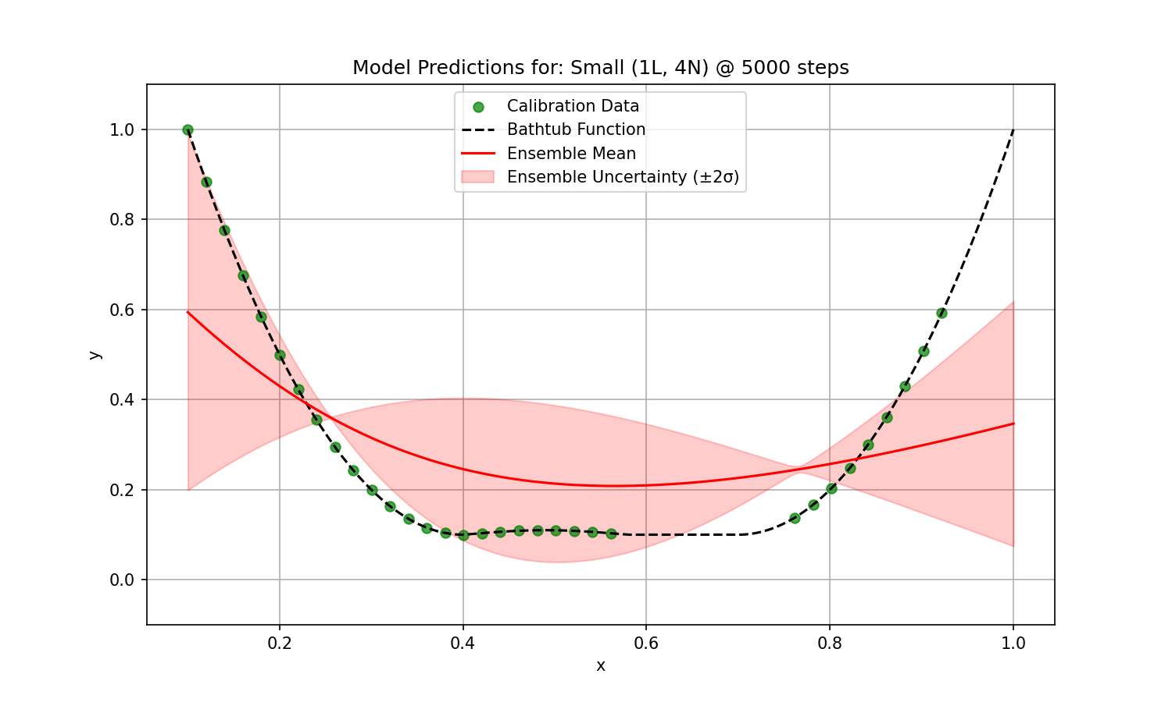
1 General Methodology – randomness
Neural network (NN) training involves randomness from weight initialization and data shuffling.
Different runs can converge to different solutions due to the non-convex loss landscape.
Ensembles (multiple instances) of models are trained per architecture using different random seeds.
Mean predictions and ±2 standard deviations are plotted to show consensus and uncertainty.

Slide 4
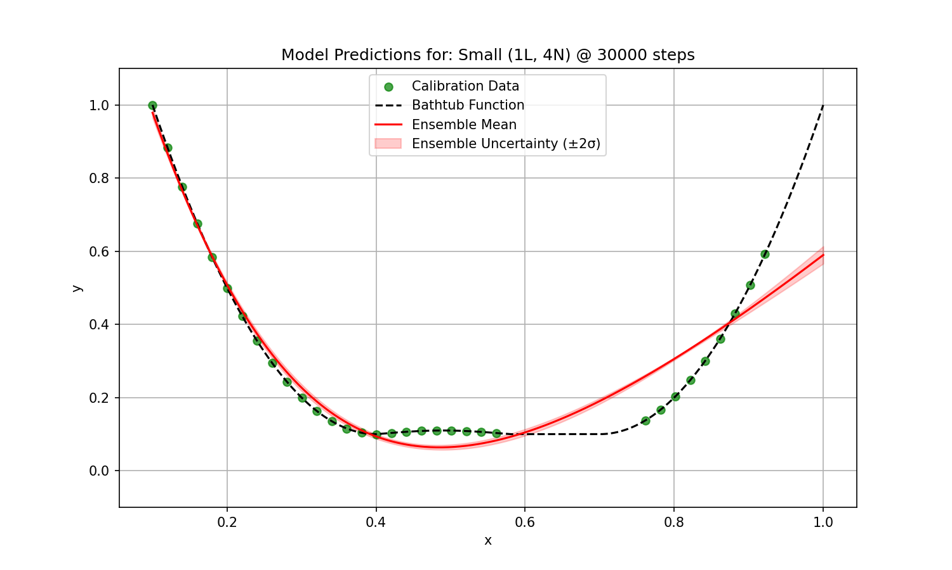
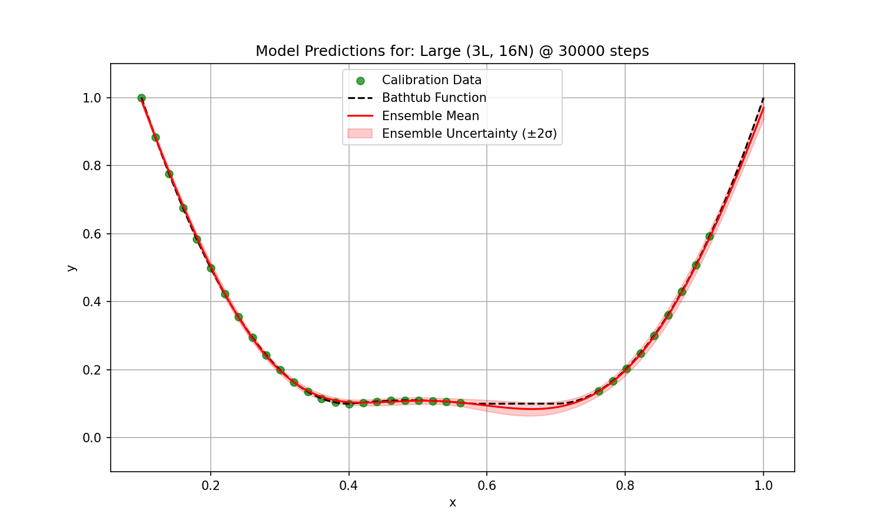
1.1 Hyperparameter Sweep – Model Size
Task Objective: Explored the impact of hidden layers, nodes on FFNN performance through a hyperparameter sweep.
Larger Models tend to have less training loss for same training steps
Small models are incapable of fitting the Bathtub function well

Slide 5
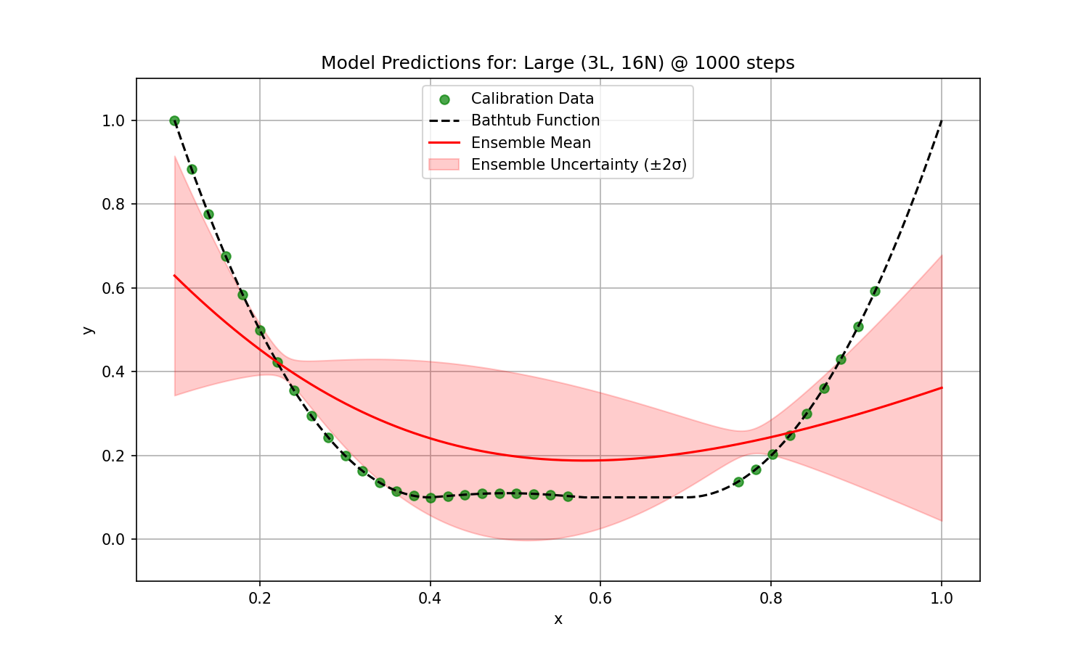
1.1 Hyperparameter Sweep – Training Steps
Task Objective: Explored the impact of epochs (training steps) on FFNN performance through a hyperparameter sweep.
Reduction of Ensemble variance
Reduction of Model Training Loss

Slide 6
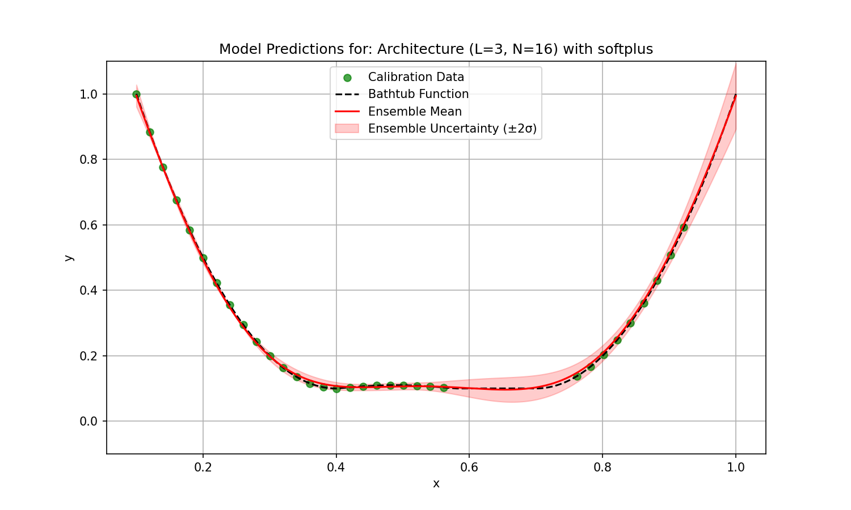
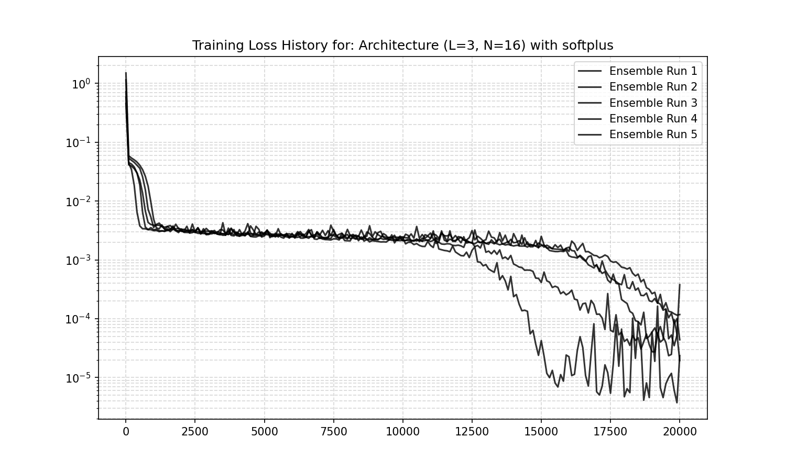
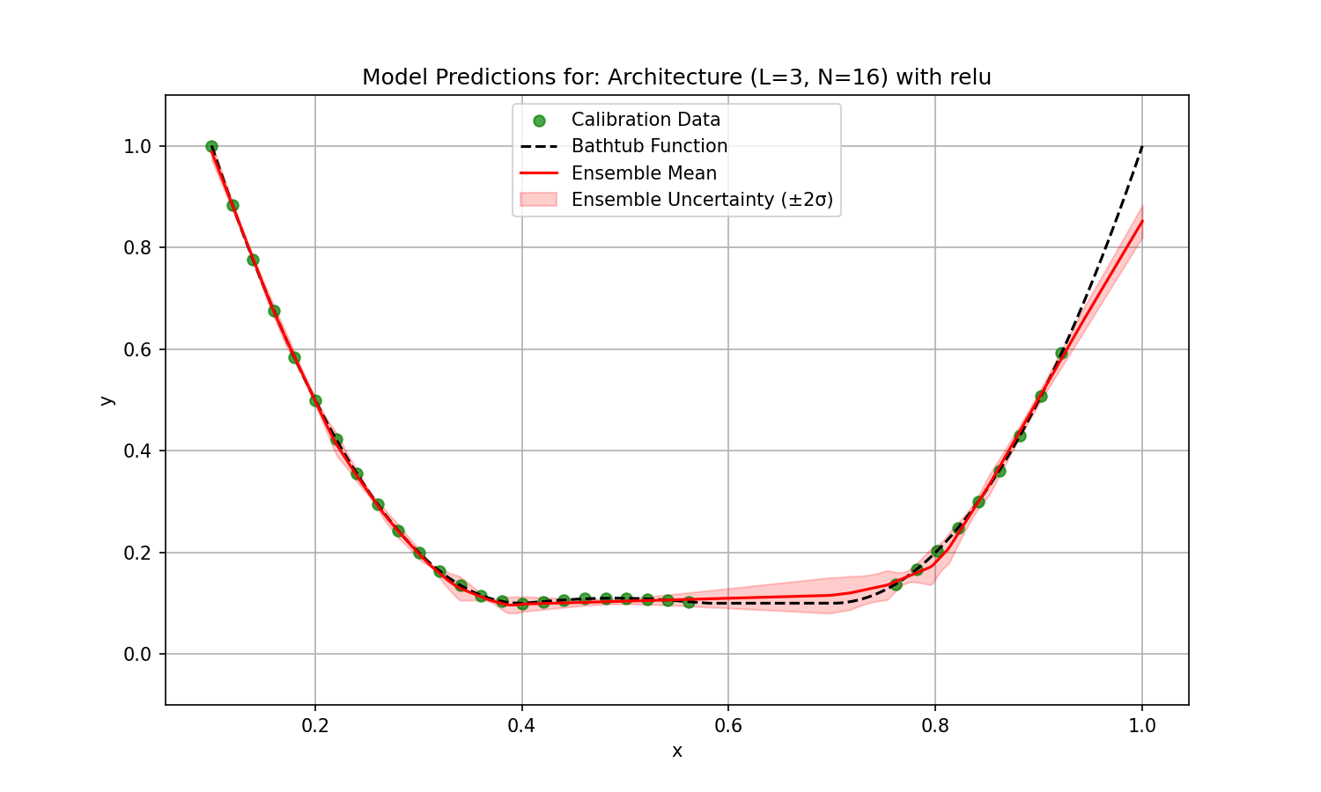
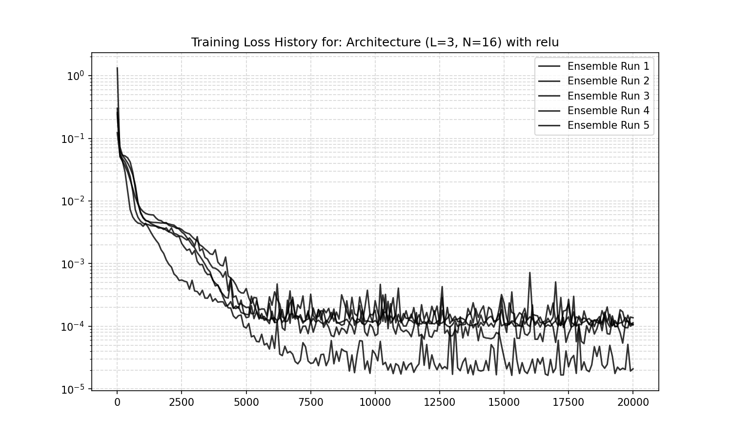
1.1 Hyperparameter Sweep – Activation Function
Task Objective: Explored the impact of activation functions on FFNN performance through a hyperparameter sweep.
Softplus:
Smooth outline
ReLU:
Partwise linear

Slide 7
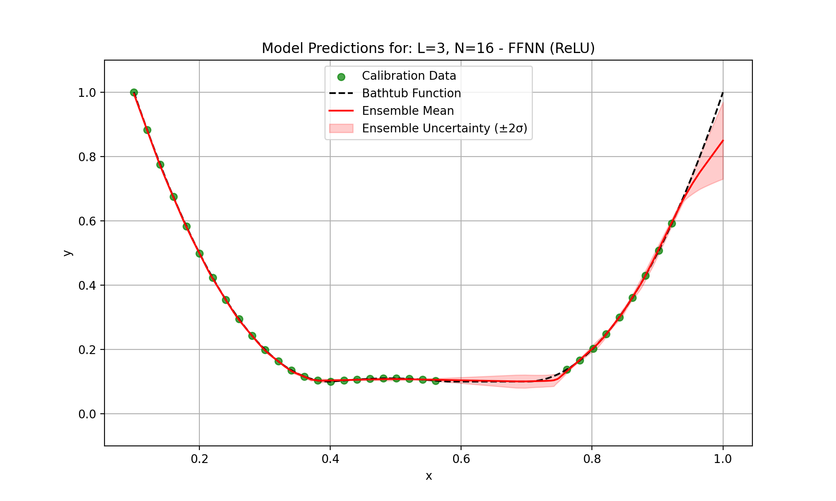
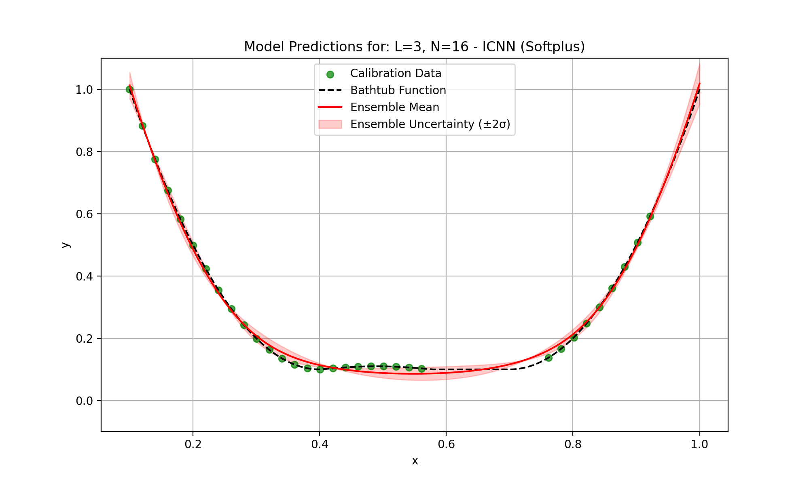
1.2 Input convex neural networks
Task Objective: Adapted a NN to enforce input convexity, enabling physically consistent modeling of a known convex process.
ICNN shows better extrapolation!
FFNN seems to overfit the training data (better interpolation) and shows bad extrapolation.

Slide 8
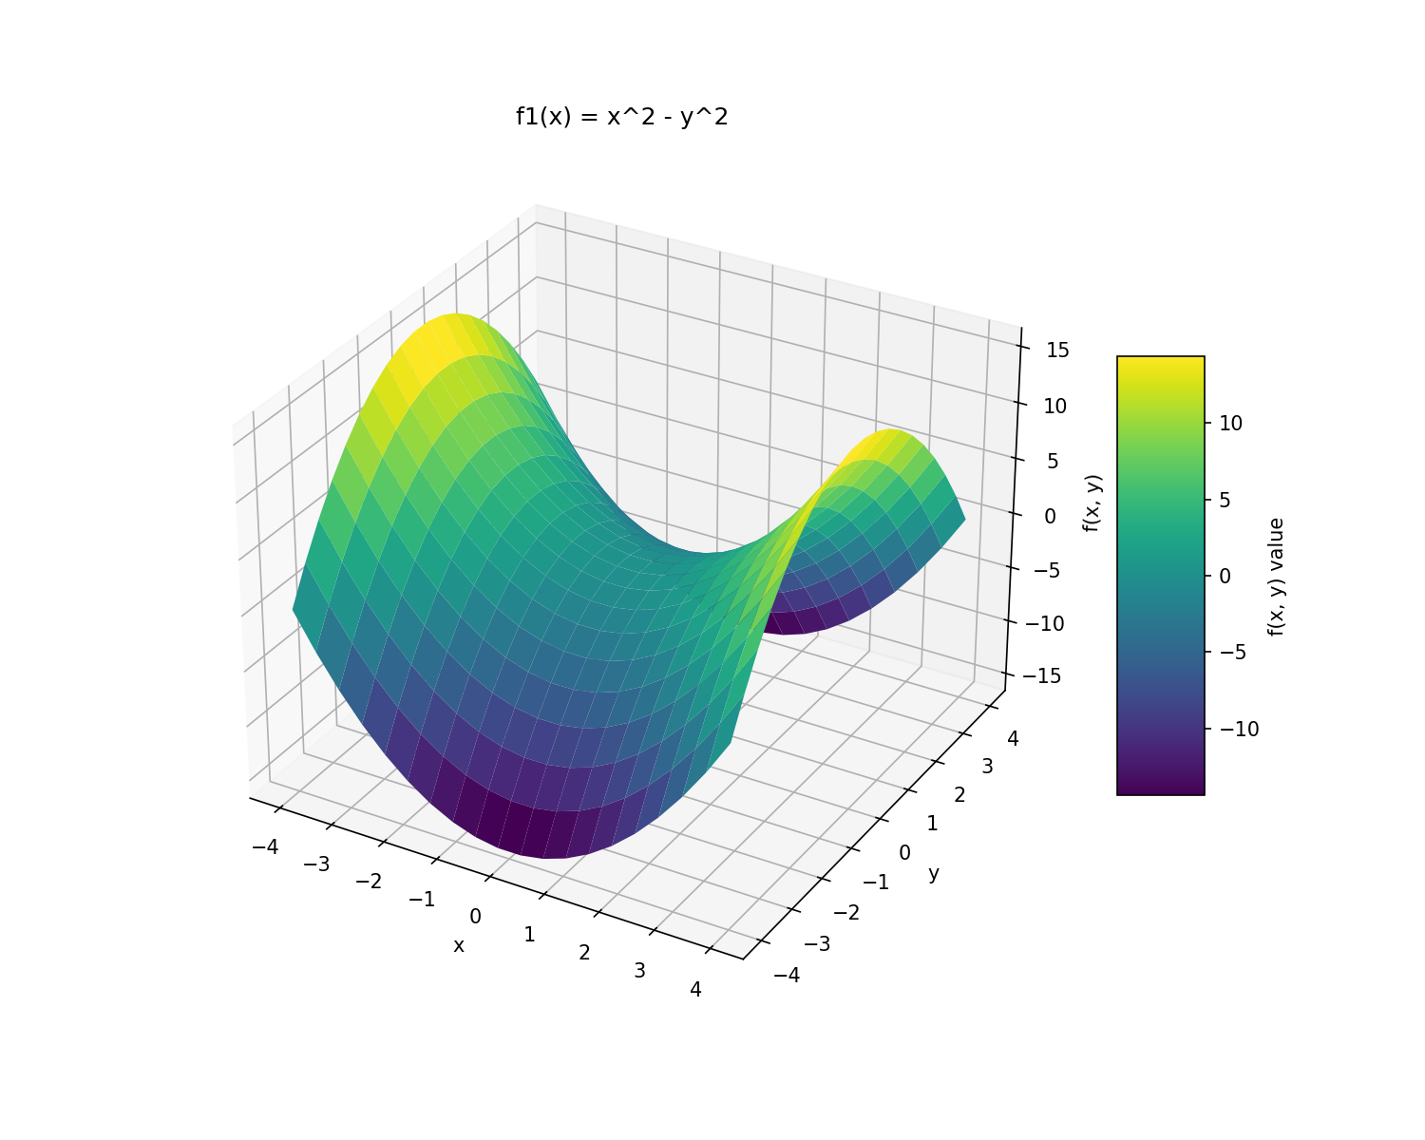
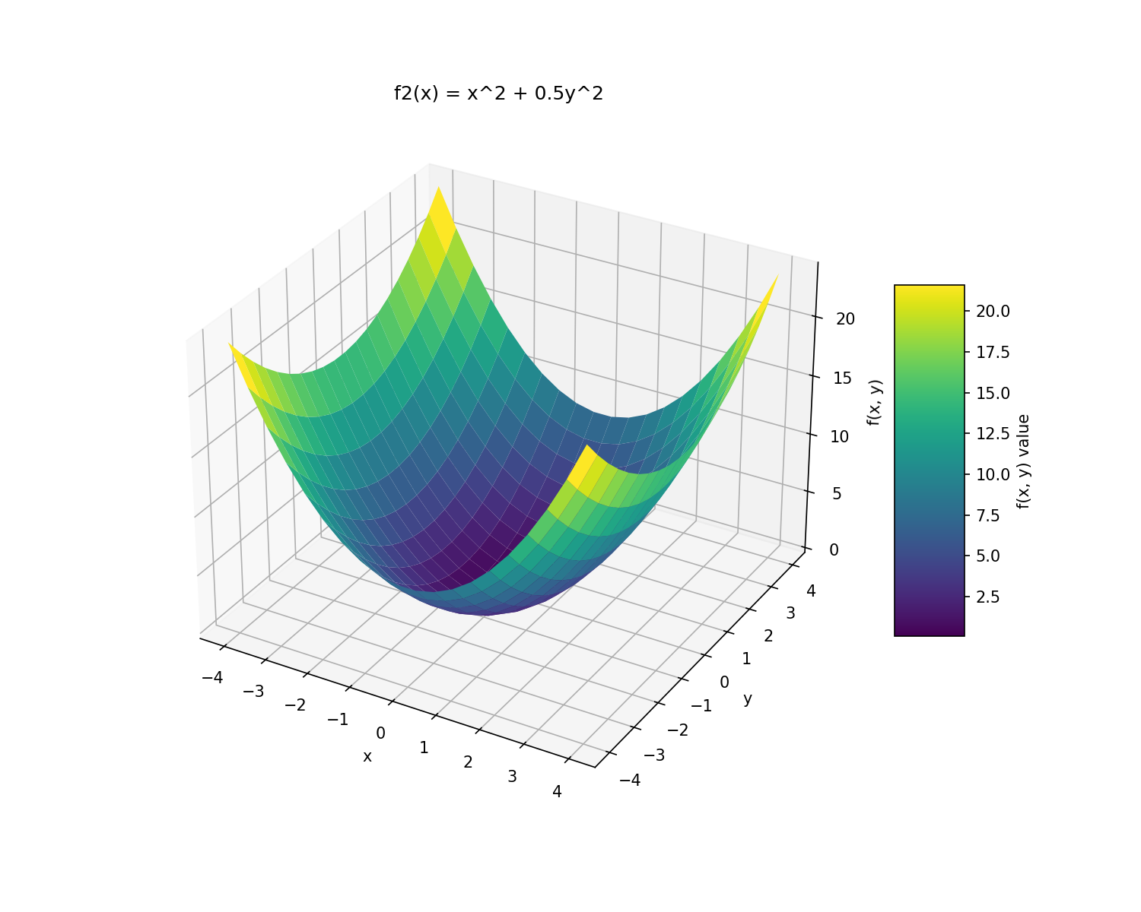
2.1 Data Generation
Task Objective: Generated synthetic data from two analytical functions (f1 and f2) and their gradients over a 2D grid for model training and evaluation.

Slide 9
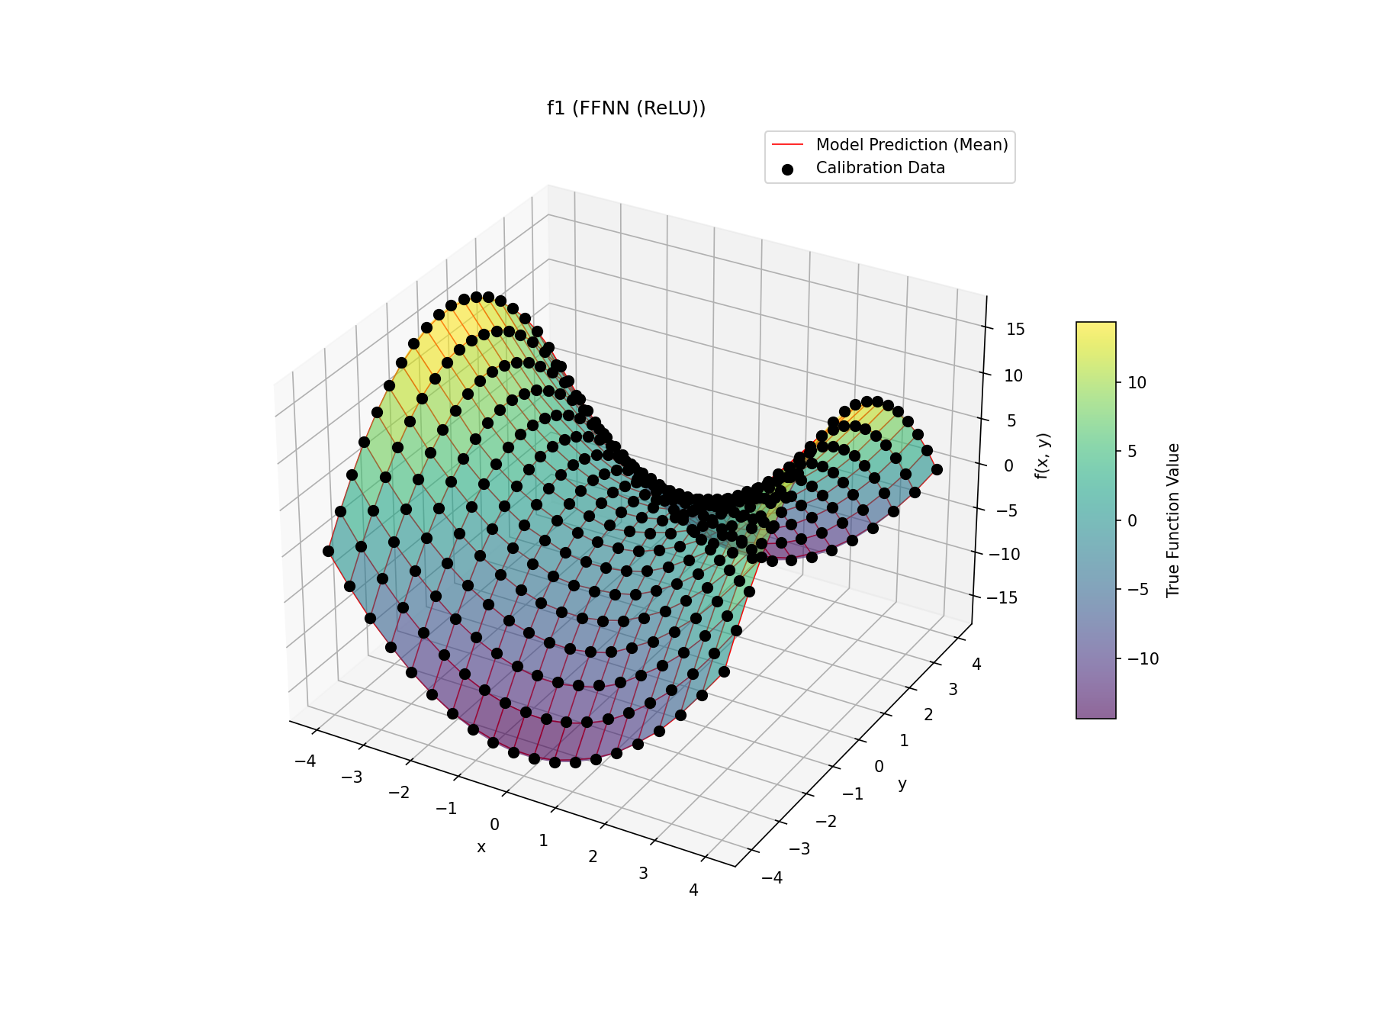
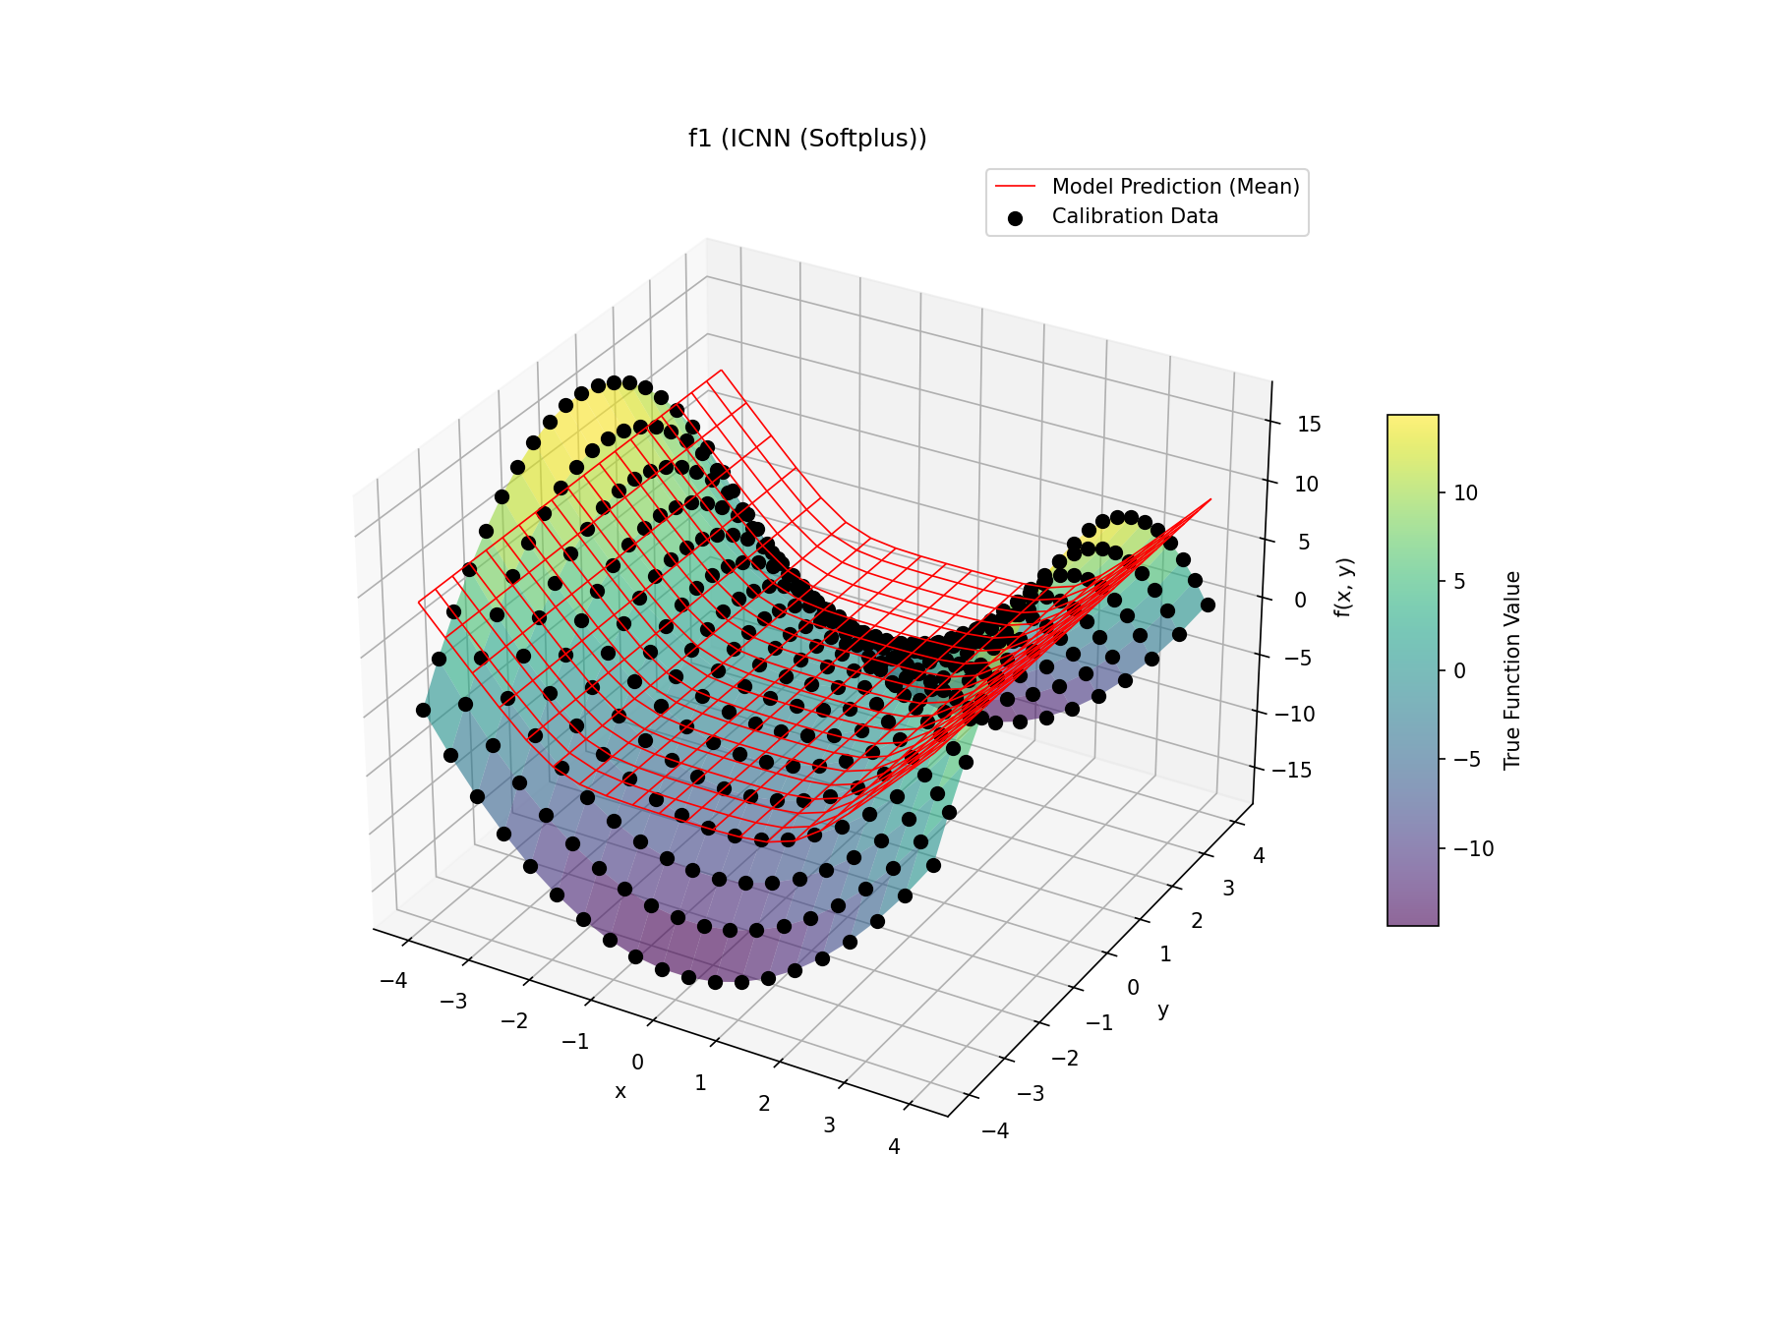
2.2 Trainable Custom Layer – F1
Task Objective: Built and compared a standard FFNN and an ICNN to learn scalar-valued functions from 2D input, highlighting the impact of convexity constraints.
For the non-convex problem (f1) the FFNN is flexible enough to fit it well, while the ICNN tries to fit a convex function which produces a terrible fit

Slide 10
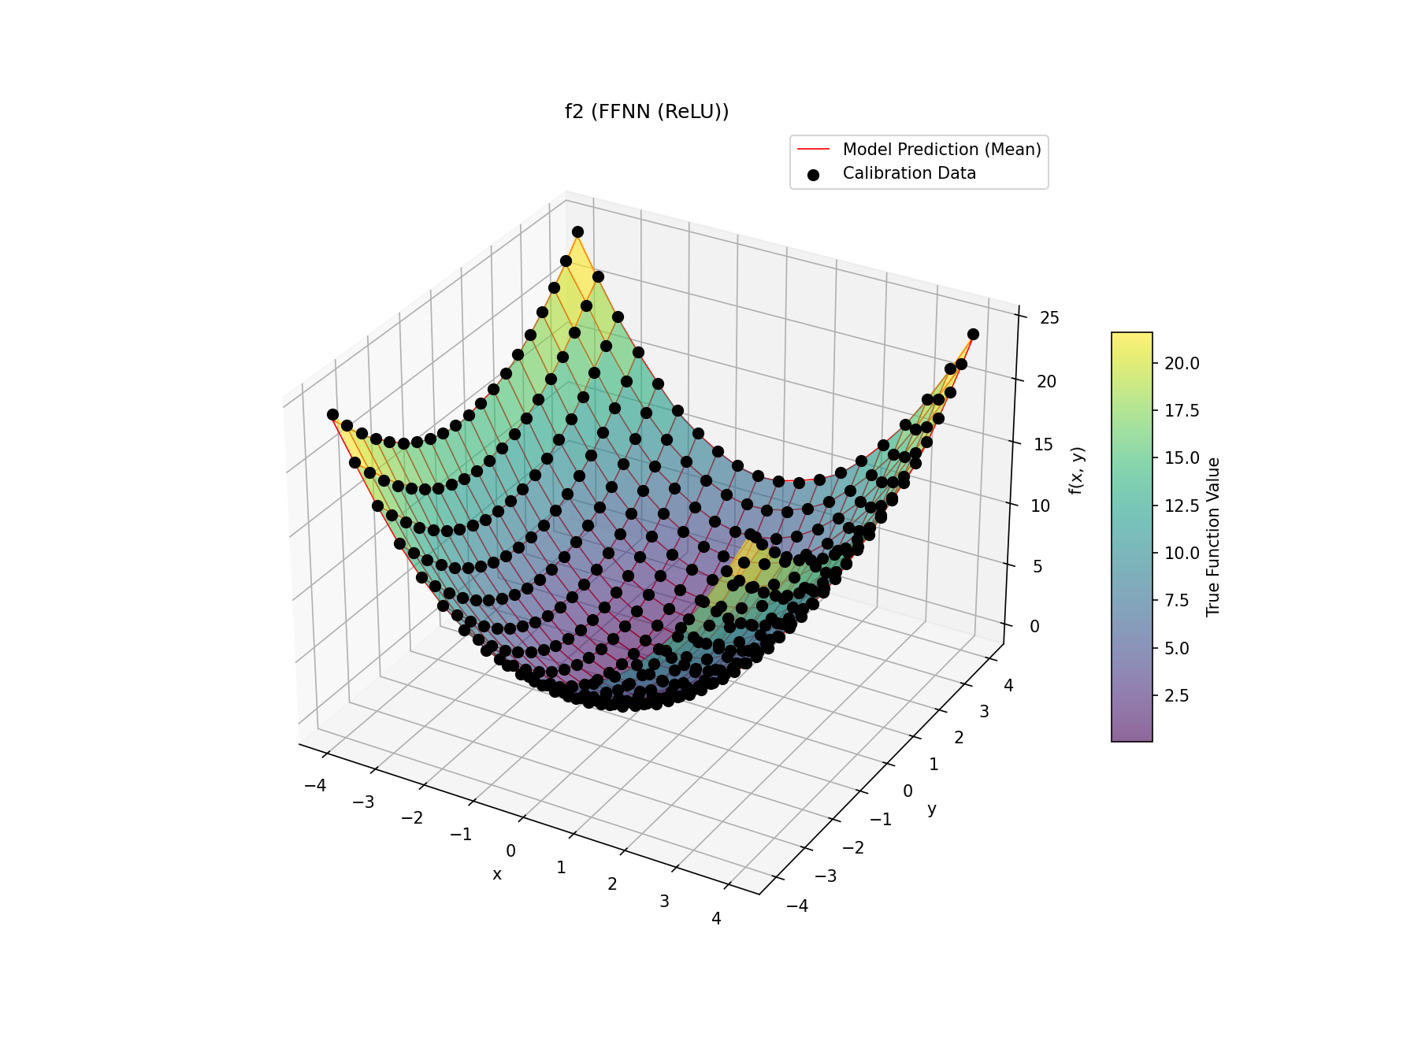

2.2 Trainable Custom Layer – F2
Task Objective: Built and compared a standard FFNN and an ICNN to learn scalar-valued functions from 2D input, highlighting the impact of convexity constraints.
For the convex problem (f2) the FFNN can still fit it well, whereas now the ICNN also exhibits a good fit.

Slide 11
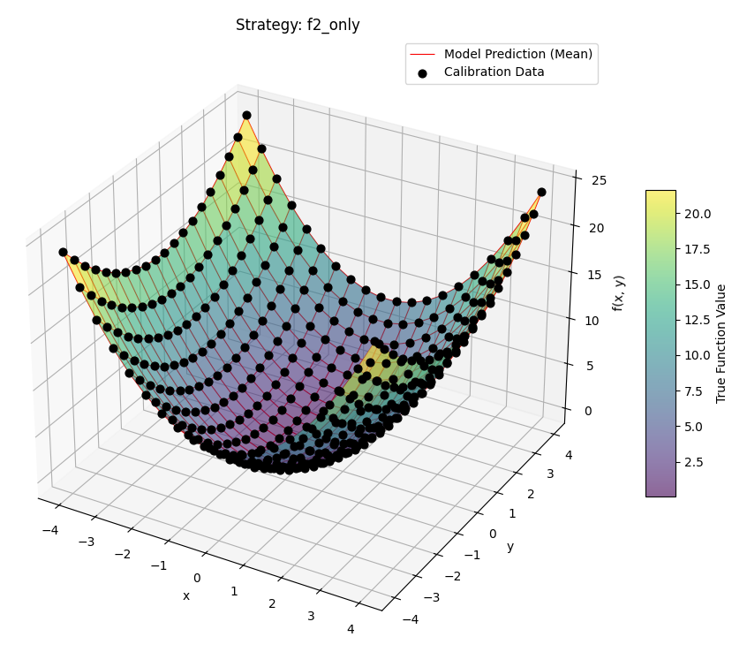
2.3 Sobolev Training
Task Objective: Extended the ICNN to output both function values and gradients, enabling Sobolev training using different calibration strategies.

Slide 12
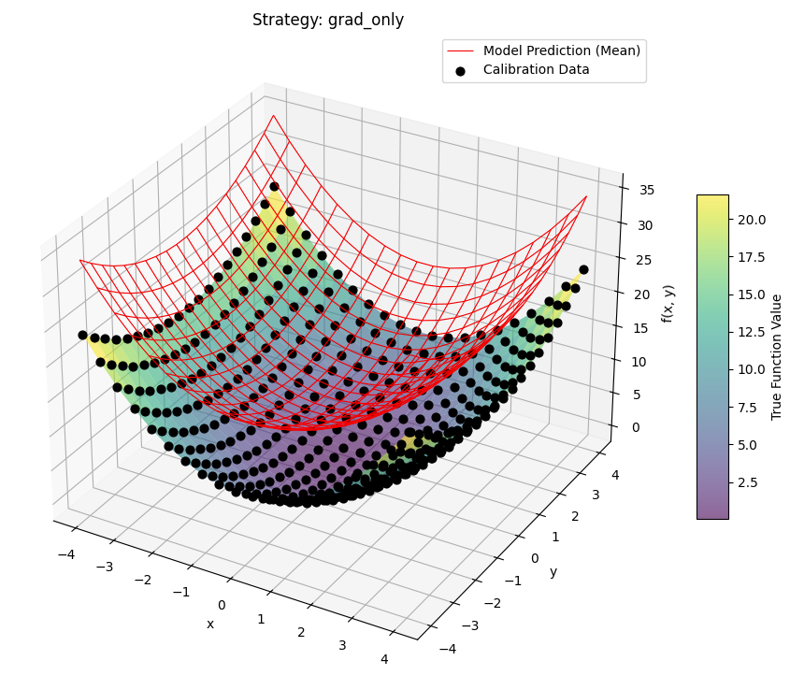
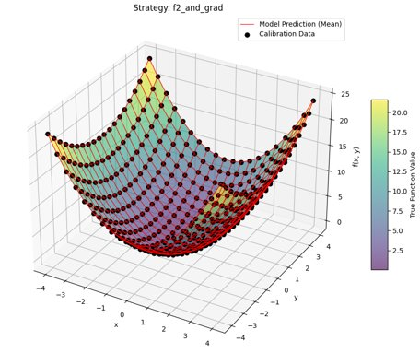
2.3 Sobolev Training
Task Objective: Extended the ICNN to output both function values and gradients, enabling Sobolev training using different calibration strategies.
Using only function values or gradient data for training overfits on the seen data.
Using both allows a good fit for both gradient and function data predictions.

Slide 13
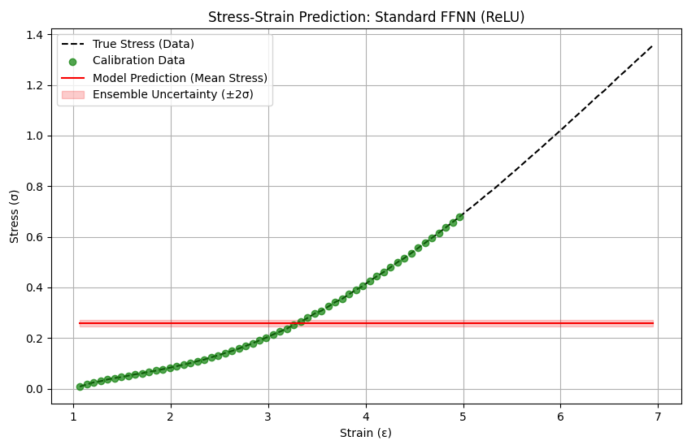
2.4 Hyperelasticity
Task Objective: Applied Sobolev-trained FFNN and ICNN models to learn stress–strain behavior in soft materials via a neural potential function.
Dying ReLU Phenomenon
The NN models W, we train on gradient data (stress)
The loss function is:
with (α=0, β=1)
Therefore, the parameter updates are proportional to the second derivative of the NN (for ReLU = 0)

Slide 14
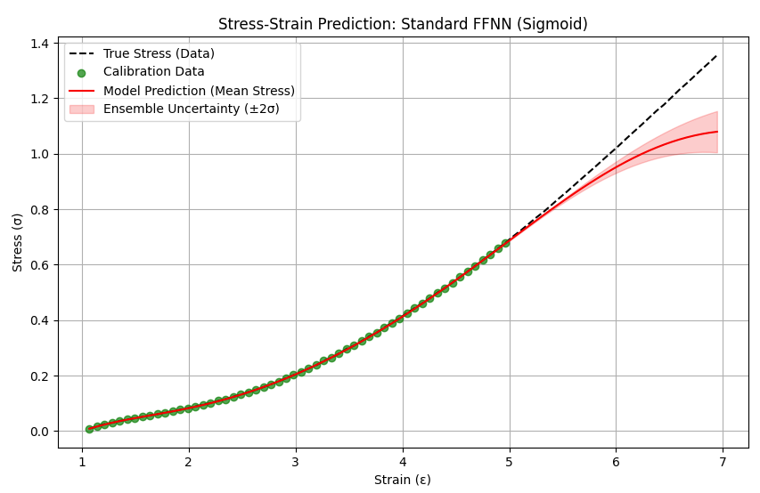
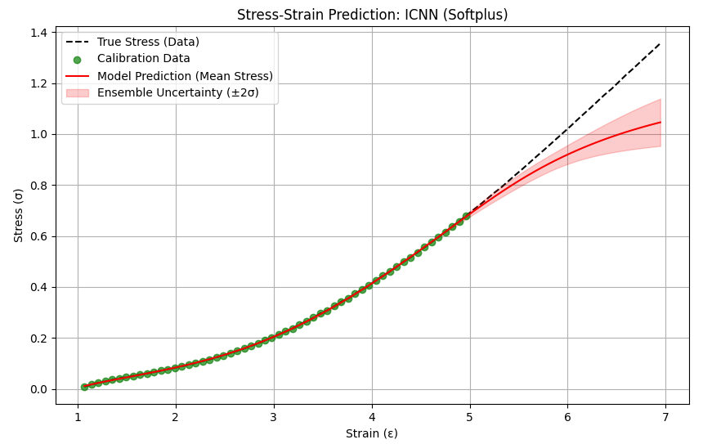
2.4 Hyperelasticity
Task Objective: Applied Sobolev-trained FFNN and ICNN models to learn stress–strain behavior in soft materials via a neural potential function.
ICNN shows non-decreasing stress strain curve enforcing physical plausibility!
FFNN allows decreasing stress which is physically not possible for hyperelasticity.

